Slide 1


Slide 2


Slide 3


Slide 4


Slide 5
Registration System Proposal
Shawn Sandberg, David Lambertson, Jacob Bowser, and Kevin Johnson

Slide 6

Problem
Solution
The registration process is stressful
The registration system is time-consuming
This leads to expenses for BYU-I
Integrate Grad Planner and registration
Introduction | Problem Statement | Objectives | Plan | Budget | Personnel and Qualifications | Facilities and Equipment
Problem and Solution | Organization

Slide 7

Organization
Problem Statement
The current registration issues
Objectives
Integrate Grad Planner and registration
Plan
Outline of task and time frames
Introduction | Problem Statement | Objectives | Plan | Budget | Personnel and Qualifications | Facilities and Equipment
Problem and Solution | Organization

Slide 8
Organization cont.
Budget
Costs of equipment and labor
Personnel and qualifications
Education and Experience
Facilities and equipment
Required materials
Introduction | Problem Statement | Objectives | Plan | Budget | Personnel and Qualifications | Facilities and Equipment
Problem and Solution | Organization

Slide 9
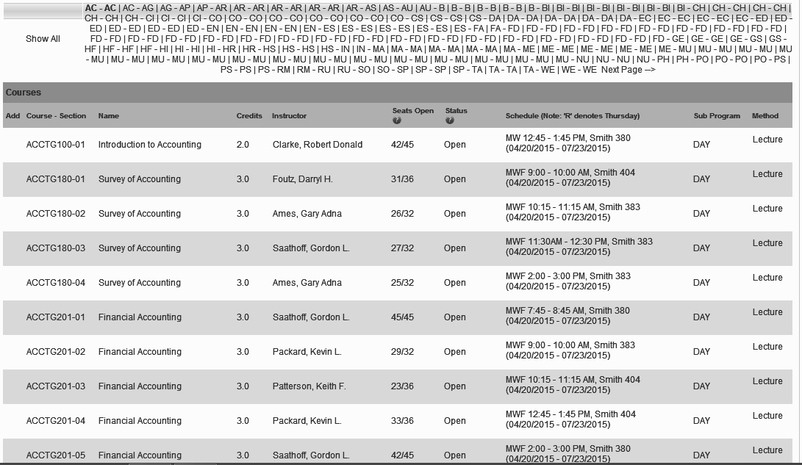
Problem Statement
The registration system is overwhelming
Stressful
Time-consuming
This leads to expenses for BYU-I
Introduction | Problem Statement | Objectives | Plan | Budget | Personnel and Qualifications | Facilities and Equipment
 | Overwhelming | Expensive

Slide 10

Overwhelming
Stressful
Registration is difficult
Adds to student load during registration
Time-consuming
Requires research
Takes away free-time of students
Introduction | Problem Statement | Objectives | Plan | Budget | Personnel and Qualifications | Facilities and Equipment
 | Overwhelming | Expensive

Slide 11
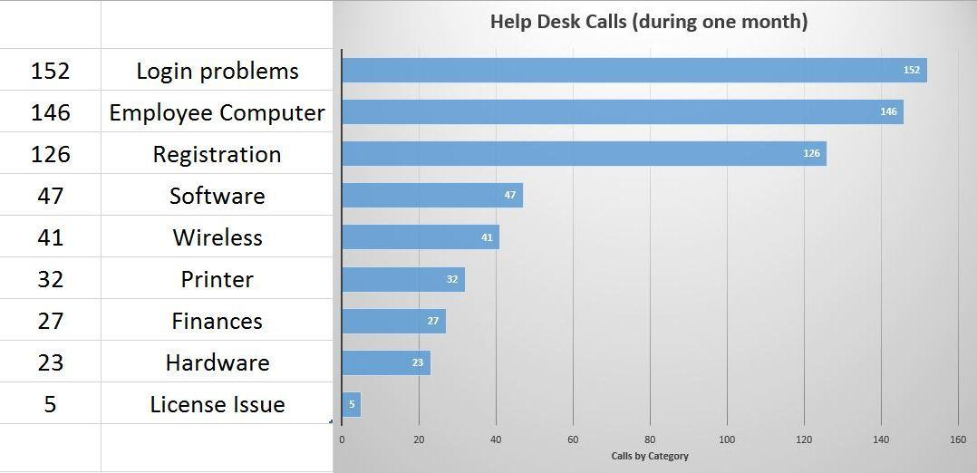
Introduction | Problem Statement | Objectives | Plan | Budget | Personnel and Qualifications | Facilities and Equipment
 | Overwhelming | Expensive

Slide 12

Expensive
Extended Help Desk hours
Students might not graduate on time
Leads to wasted tithing Funds
Introduction | Problem Statement | Objectives | Plan | Budget | Personnel and Qualifications | Facilities and Equipment
 | Overwhelming | Expensive

Slide 13

Objectives
Registration
Grad Planner
Introduction | Problem Statement | Objectives | Plan | Budget | Personnel and Qualifications | Facilities and Equipment
 |  | Integration

Slide 14

Objectives
Registration
Grad Planner
Introduction | Problem Statement | Objectives | Plan | Budget | Personnel and Qualifications | Facilities and Equipment
 |  | Integration

Slide 15


Objectives
Registration
Grad Planner
Introduction | Problem Statement | Objectives | Plan | Budget | Personnel and Qualifications | Facilities and Equipment
 |  | Integration

Slide 16

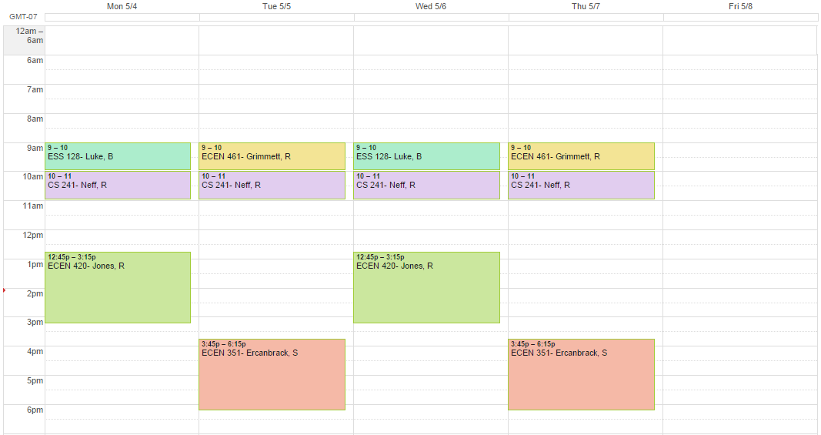
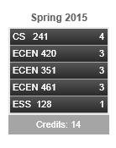

Integration
Introduction | Problem Statement | Objectives | Plan | Budget | Personnel and Qualifications | Facilities and Equipment
 |  | Integration

Slide 17
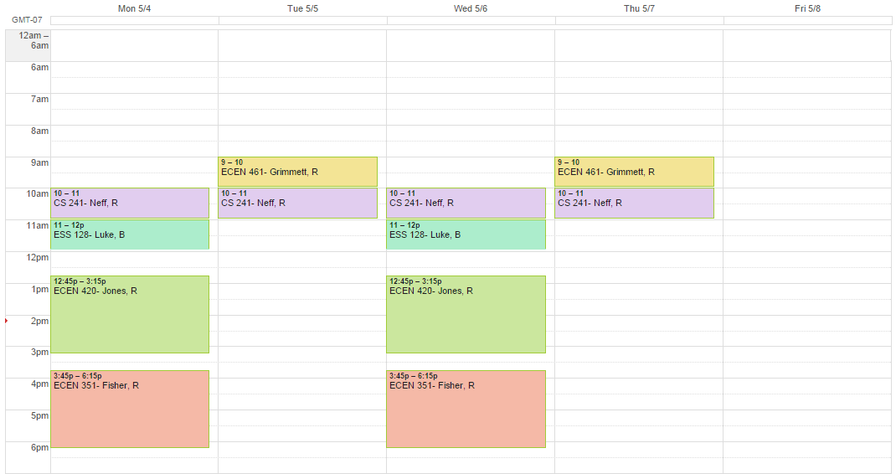
Integration
Introduction | Problem Statement | Objectives | Plan | Budget | Personnel and Qualifications | Facilities and Equipment
 |  | Integration

Slide 18
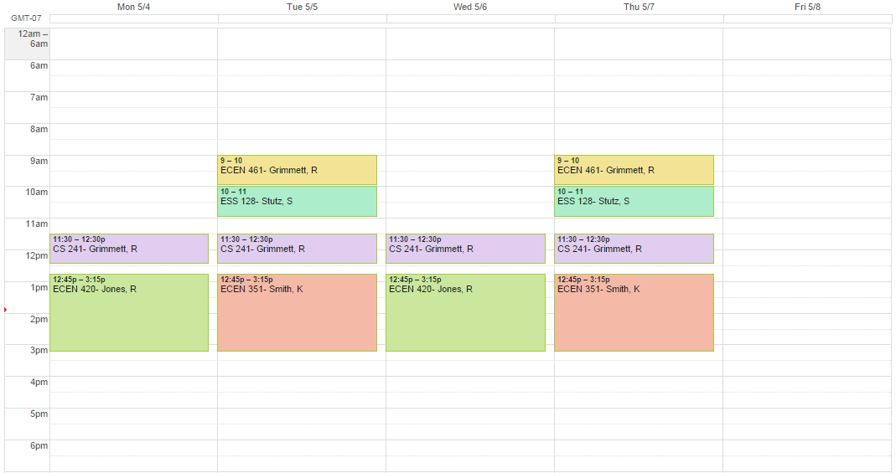

Integration
Introduction | Problem Statement | Objectives | Plan | Budget | Personnel and Qualifications | Facilities and Equipment
 |  | Integration

Slide 19
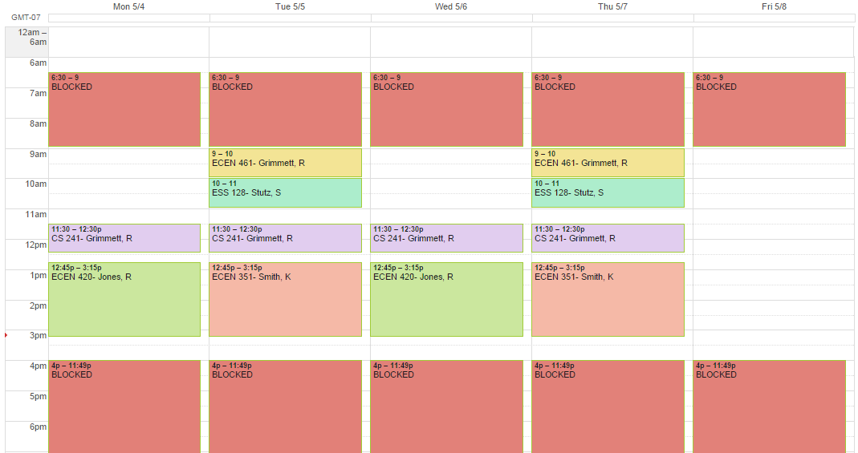
Integration
Introduction | Problem Statement | Objectives | Plan | Budget | Personnel and Qualifications | Facilities and Equipment
 |  | Integration

Slide 20
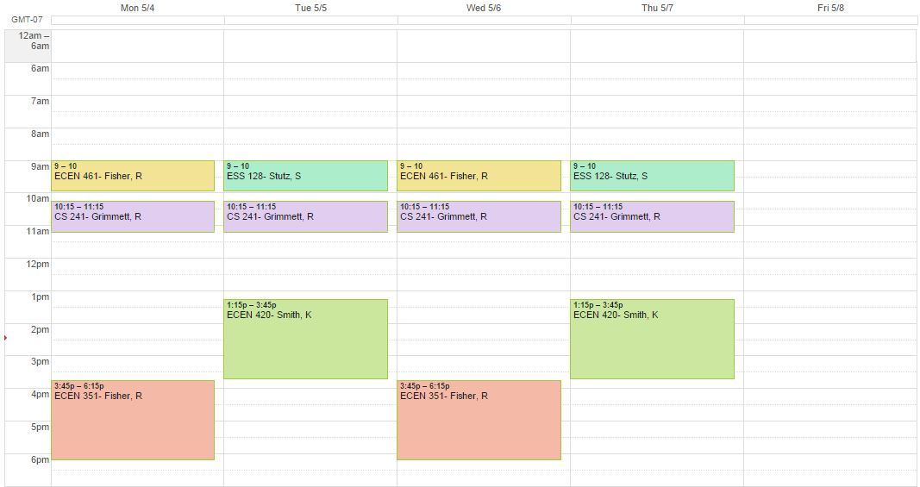
Integration
Introduction | Problem Statement | Objectives | Plan | Budget | Personnel and Qualifications | Facilities and Equipment
 |  | Integration

Slide 21
Integration
Introduction | Problem Statement | Objectives | Plan | Budget | Personnel and Qualifications | Facilities and Equipment
 |  | Integration

Slide 22
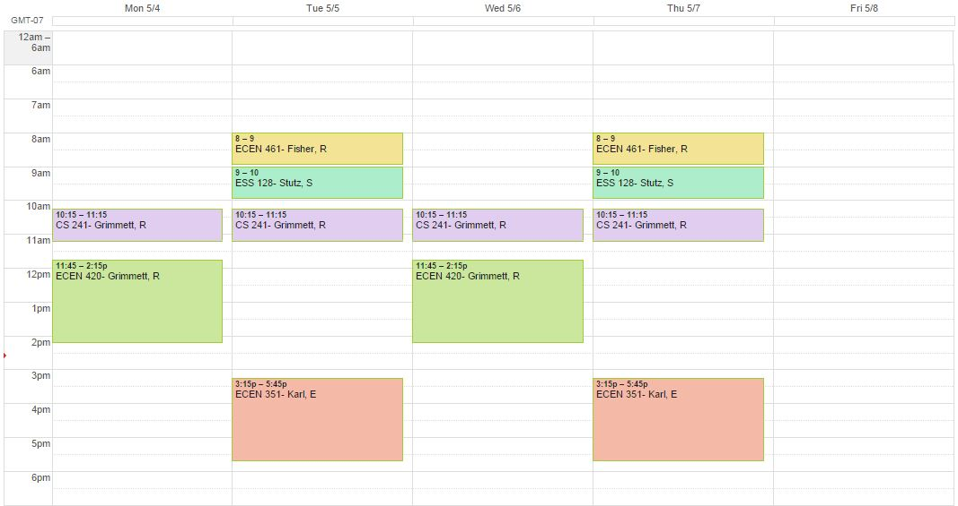
Integration
Introduction | Problem Statement | Objectives | Plan | Budget | Personnel and Qualifications | Facilities and Equipment
 |  | Integration

Slide 23
Integration
Introduction | Problem Statement | Objectives | Plan | Budget | Personnel and Qualifications | Facilities and Equipment
 |  | Integration

Slide 24
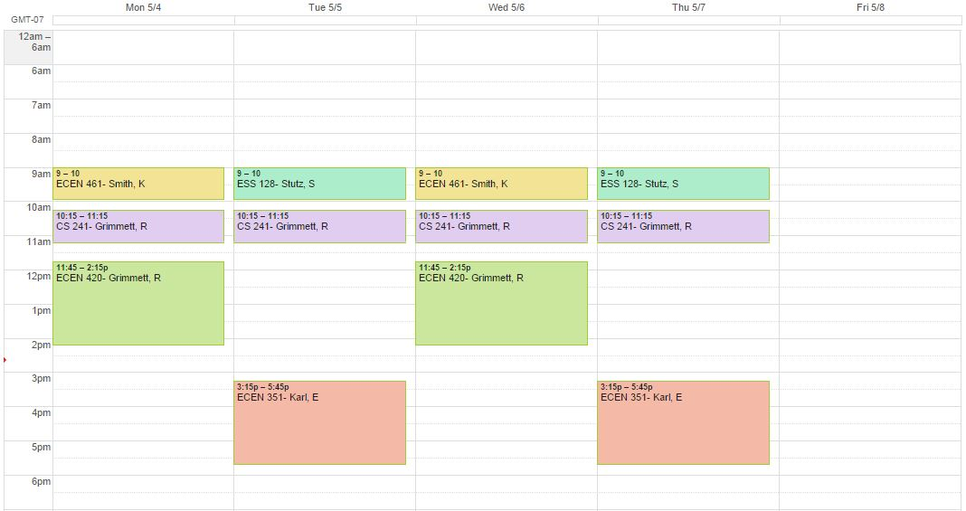
Integration
Introduction | Problem Statement | Objectives | Plan | Budget | Personnel and Qualifications | Facilities and Equipment
 |  | Integration

Slide 25

Integration
Introduction | Problem Statement | Objectives | Plan | Budget | Personnel and Qualifications | Facilities and Equipment
 |  | Integration

Slide 26


Integration
BYU-IDAHO
SERVERS
Introduction | Problem Statement | Objectives | Plan | Budget | Personnel and Qualifications | Facilities and Equipment
 |  | Integration

Slide 27
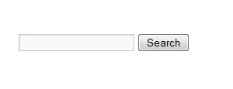
Integration
Introduction | Problem Statement | Objectives | Plan | Budget | Personnel and Qualifications | Facilities and Equipment
 |  | Integration

Slide 28
Integration
tech com
Introduction | Problem Statement | Objectives | Plan | Budget | Personnel and Qualifications | Facilities and Equipment
 |  | Integration

Slide 29
Integration
tech com
RESULTS:
CS 308-01 CS 308-02 | Technical Communication Technical Communication | Dewall, Robyn Twitchell, Kevin
Introduction | Problem Statement | Objectives | Plan | Budget | Personnel and Qualifications | Facilities and Equipment
 |  | Integration

Slide 30
Integration
grimmett, cs 124
Introduction | Problem Statement | Objectives | Plan | Budget | Personnel and Qualifications | Facilities and Equipment
 |  | Integration

Slide 31
Integration
grimmett, cs 124
RESULTS:
CS 124-3 | Intro to Software Development | Grimmett, Richard Ralph
Introduction | Problem Statement | Objectives | Plan | Budget | Personnel and Qualifications | Facilities and Equipment
 |  | Integration

Slide 32

Plan
Weeks 1 - 2 - Setup
Weeks 3 - 7 - Programming
the system
Weeks 8 - 12 - Begin Testing
Introduction | Problem Statement | Objectives | Plan | Budget | Personnel and Qualifications | Facilities and Equipment
 |  |  | Weeks 1-2 | Weeks 3-7 | Weeks 8-12
Notes:
hi this is the plan slide

Slide 33
Weeks 1-2
Week 1 - Setup of our Systems and organizing of software needed
Week 2 - Becoming familiar with the data we will be working with.
Introduction | Problem Statement | Objectives | Plan | Budget | Personnel and Qualifications | Facilities and Equipment
 |  |  | Weeks 1-2 | Weeks 3-7 | Weeks 8-12

Slide 34
Weeks 3-7
Programming:
Client side - Change the search function
(HTML, CSS) Display the different schedules
Server side - Pull the correct information and
(Java, C++) build the schedules
Introduction | Problem Statement | Objectives | Plan | Budget | Personnel and Qualifications | Facilities and Equipment
 |  |  | Weeks 1-2 | Weeks 3-7 | Weeks 8-12
Notes:
The entire project will require both client side and server side programming. The client side involves creating the layout of displaying the different schedules for registering. Also, to change the search, we need to work on the client side.
Server side programming will involve parsing the data and the actual building of the schedules. This information will get passed to the client side which displays it nicely for the user.s

Slide 35
Weeks 8 - 12
Week 8 - Begin testing
Week 9 - Open to public for alpha and beta testing
Week 11 - Launch the new system
Week 12 - Pack up/handling any missed bugs
Introduction | Problem Statement | Objectives | Plan | Budget | Personnel and Qualifications | Facilities and Equipment
 |  |  | Weeks 1-2 | Weeks 3-7 | Weeks 8-12
Notes:
Testing starts with alpha testing. Testing will continue through to week 12. In week 10 we will begin beta testing.

Slide 36
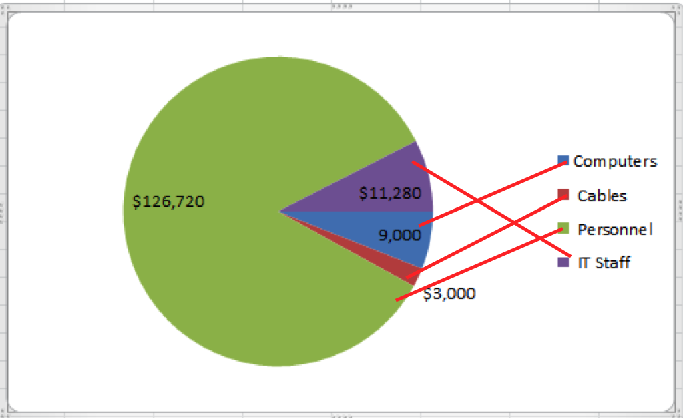
Budget
Total:$150,000
Introduction | Problem Statement | Objectives | Plan | Budget | Personnel and Qualifications | Facilities and Equipment

Slide 37

Personnel and Qualifications
David - HTML5, CSS, Java, JavaScript,
C++, XML, PHP, and databases
Jacob - C++, HTML, CSS,
and JavaScript
Kevin - C++, Java, HTML5, CSS,
JavaScript, and PHP
Shawn - C++ and Python
Introduction | Problem Statement | Objectives | Plan | Budget | Personnel and Qualifications | Facilities and Equipment
Notes:
Together the team has over 7 years of experience in programming and is well suited to the task at hand
These qualifications are beneficial because we will be working with the server side of web data. This is done through programming using C++, PHP and Java. We also need an understanding of HTML5 so we can interact with the client side of registration.
Background source: http://blog.toggl.com/wp-content/uploads/sites/5/2014/10/programmer-at-work.jpg

Slide 38

Facilities and Equipment
Workstation computers
Server
Access to Grad Planner
Registration IT Staff
Access to the registration system
Introduction | Problem Statement | Objectives | Plan | Budget | Personnel and Qualifications | Facilities and Equipment
Notes:
Workstation computers - For secure access to the registration system
Server - Hold information from the registration system, while handling population of the school accessing it during registration
Access to Grad Planner - Interface directly with Grad planner to create schedules
Registration IT Staff - Someone familiar with the system to help us integrate the new system
Access to registration system - With this, we can pull the course data, schedule, and available seats
background source: http://www.gfi.com/blog/wp-content/uploads/2013/06/MSP-Workstation-Management.jpg

Slide 39

Conclusion
This new system will solve many of the problems with the current registration system.
Students will be able to create schedules more quickly and IT costs will go down.
Notes:
Image source: http://www.timberwindowsesher.com/files/Dollarphotoclub_40148187.jpg

Slide 40
Sources
Register Icon - http://thumbs.dreamstime.com/z/register-now-16531339.jpg
Stressed Student- http://stopstudentstress.com/wp-content/uploads/2010/07/iStock_000002806456XSmall.jpg
Stressed Employee- http://a57.foxnews.com/global.fbnstatic.com/static/managed/img/fb/Sbc/biz-on-main/660/371/Business-Man-Phone-Stressed.jpg?ve=1&tl=1
Expenses- http://free.clipartof.com/70-Free-Retro-Clipart-Illustration-Of-A-Worried-Businessman-Holding-Large-Bill-Statement.svg
Repair man- http://img3.wikia.nocookie.net/__cb20130422180857/disney/images/9/9e/FixItFelixJrHQ.png
Clip board- http://walrus.wr.usgs.gov/infobank/programs/html/training/IBDemo/rawjpg/Clipboard.jpg
https://my.byui.edu/ICS/Academics/Academic_Information.jnz?portlet=Registration&screen=Add+Drop+Courses+BYUI&screenType=next
Graph - Shawn Sandberg -Data from BYU-Idaho’s Help Desk Team Dynamix report http://td.byui.edu/TDNext/Home/Desktop/Default.aspx
Money - http://cdn2.hubspot.net/hub/196184/file-28283183-jpeg/images/burningmoney.jpeg
Man at computer - http://blog.toggl.com/wp-content/uploads/sites/5/2014/10/programmer-at-work.jpg
Computer - http://www.gfi.com/blog/wp-content/uploads/2013/06/MSP-Workstation-Management.jpg
Thumbs up - http://www.timberwindowsesher.com/files/Dollarphotoclub_40148187.jpg

